Slide 1
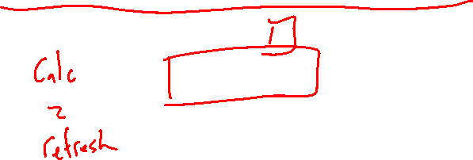
Section 1.2 Math Preliminaries
Lecture 1
Taylor series
Notes:
Section is shorter than most

Slide 2

Homework Submission to Canvas
Preview of section
Skim the section in text and write a short paragraph summary.
Give a bulleted list of all important definitions, theorems, and formulas without details.
Notes on video lectures
Take notes on everything written on slides including all details, worked examples, on-own activities, as well as your own thoughts and questions.
Try on-own activities first, then write down provided solution next to it for comparison.
Worked examples from the text
Write down the problem and attempt without looking at the solution.
Use the solution to write the best explanation you can.
Solutions to textbook exercises
Model approaches and explanations given in the video lectures and textbook examples.
Final reflection of section
List the key takeaways to remember as a bulleted list.
Notes:
Mention graded for completion and quality of writing.

Slide 3
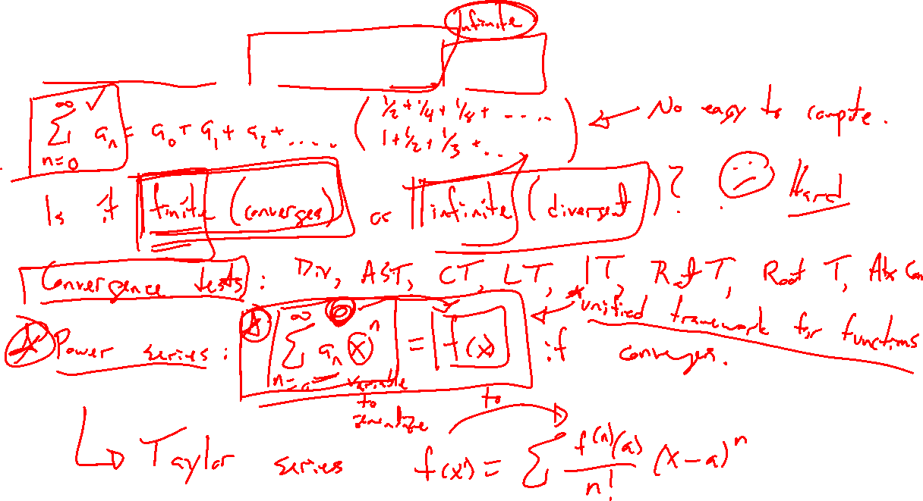
Try on own: Calculus 2 series recap
Notes:
Bullet list of ideas, no details.

Slide 4
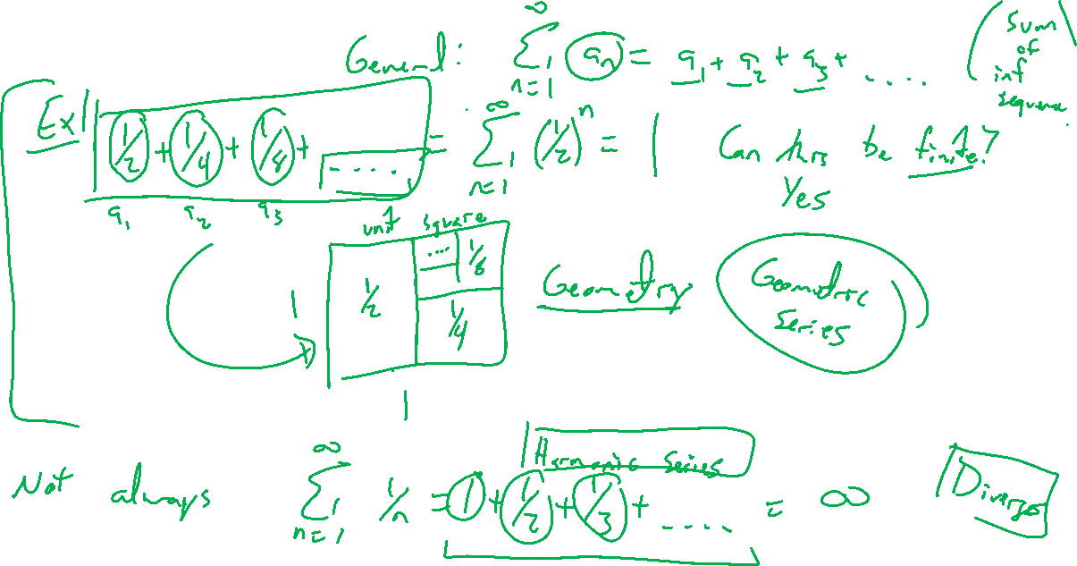
Infinite series
Notes:
Infininte process/accumulation. Can it possibly be finite?
½ + ¼ + 1/8 + …. = 1 as area of a square.
Write as summation notation. Key is a_n decays to zero fast enough.
Harmonic series diverges.
Big discussion in theory / foundation of math in 18/19th centuries.

Slide 5
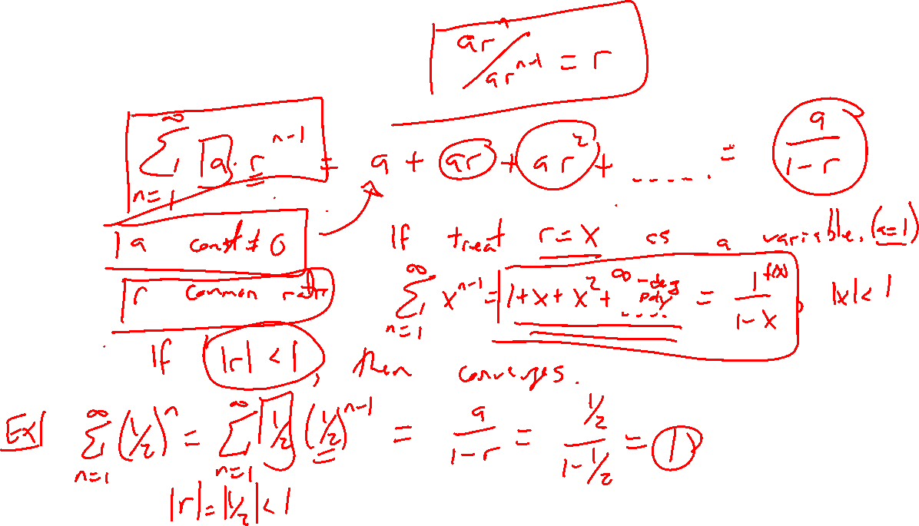
Geometric series
Notes:
General case.
Replace with x to see power series idea. Function. RoC.
Graph in desmos to see polynomial approximation.

Slide 6
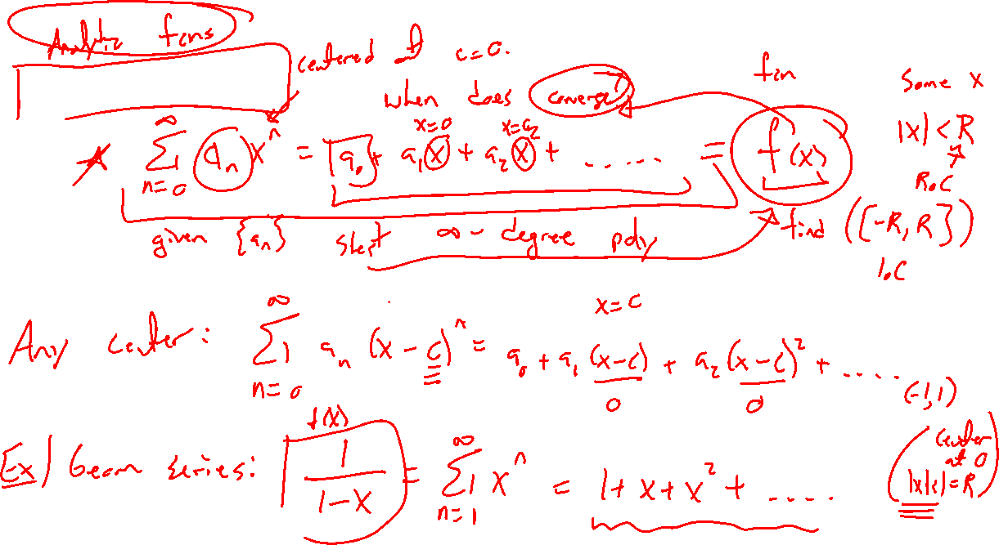
Power series
Notes:
General case for sequence c_n. Does it converge? If so to what? For what x?
Radius / interval of convergence.

Slide 7
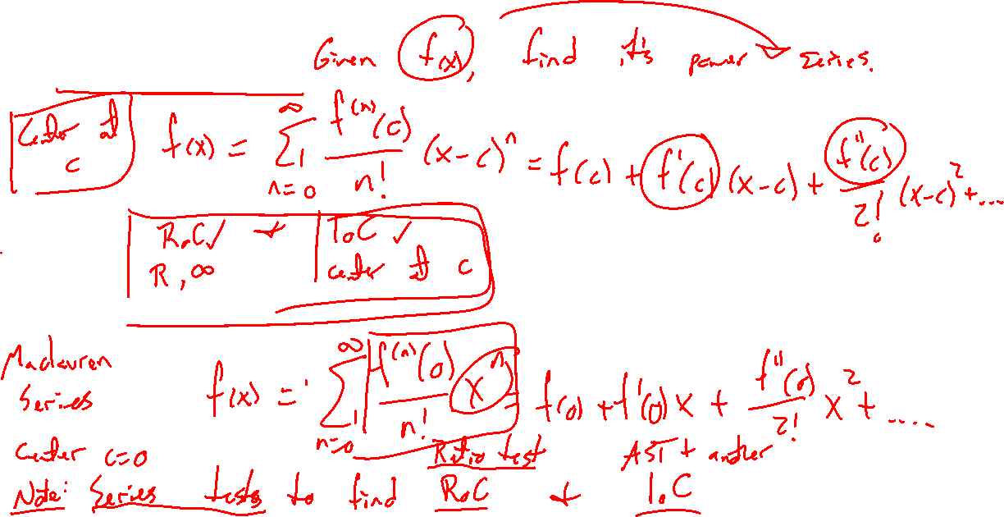
Taylor series
Notes:
A general formula to go from function to power series.
Care about convergence, RoC, and IoC.
Special case, center at a=0 gives Maclaurin series.
Series tests allow you to decide where converges (Ratio test main, AST for endpoint, other test for other endpoint)

Slide 8
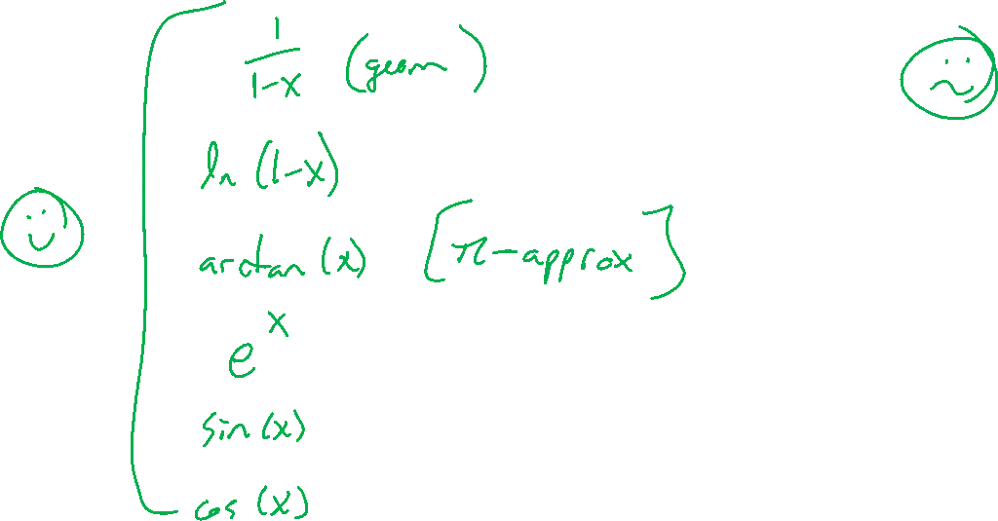
Taylor series to know
Notes:
E^x, \sin(x), \cos(x), \ln(1+x), 1/(1-x), arctan(x)
Will derive some in HW

